Slide 1
CSC 362: System Programming
Lecture 11
Original slides by: Amitabha Dey
Adapted by: Dr. Richard Johnson
Department of Computer Science University of North Carolina at Greensboro

Slide 2

Status Check
Compilation Stages
Preprocessing, Compiling, Assembling, Linking
Static Linking vs Dynamic Linking
Shared Library Versioning
-FPIC, -shared, .so files
What we will cover today
Static Library - Creating archive (.a) files
Understanding Linkers
Relocation during Linking - Symbol Tables
Static vs Dynamic Relocation
Inspection using objdump, nm, vmmap

Slide 3
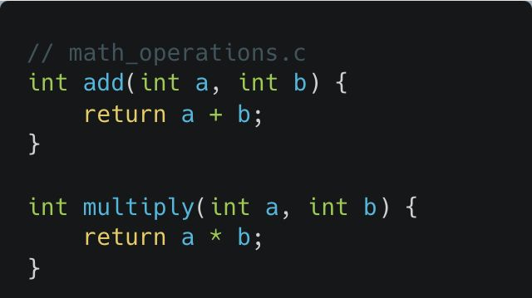
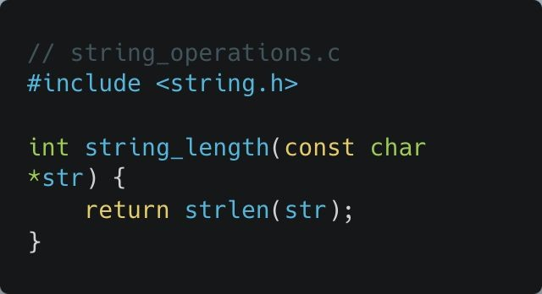
Static Linking and Static Libraries
math_operations.c
string_operations.c
Compile both C files into object files
gcc -c math_operations.c string_operations.c
Notes:
Concept: A static library is a collection of precompiled object files (.o) bundled into a single archive file (.a on Unix/Linux or .lib on Windows).
See example:
Static Library directory
Compilation:
Use gcc -c math_operations.c string_operations.c to create object files.

Slide 4
Advantages
Disadvantages
Increased File Size:
Including all the necessary library code in each executable means that the resulting file will be larger, leading to potential disk space and memory usage inefficiencies.
Difficulty in Updating:
If there's a bug or update needed in the library, you have to recompile and redistribute all executables that use it, which can be time-consuming.
Simplicity and Portability:
Since all the code needed from the library is included in the executable, you don't need to worry about the library being present on the target machine when you distribute your application. This makes static linking useful for deployment, as your executable is self-sufficient.
No Runtime Dependencies:
Because the code from the library is embedded into the executable, there is no dependency on external library files (.so files) at runtime, reducing the risk of issues related to missing libraries or incompatible versions.
Performance:
A statically linked program can be faster at runtime because there’s no need to resolve symbols dynamically, as everything is already in the executable. This can lead to slight performance improvements, especially for smaller, frequently used programs.
Notes:
Advantages:
Simplicity & Portability: The executable is self-sufficient because all library code is included; the target machine doesn't need the library pre-installed.
No Runtime Dependencies: Reduces risks of missing or incompatible library versions at runtime.
Performance: Faster runtime as symbols are already resolved.
Disadvantages:
Increased File Size: Larger executables consume more disk and memory space.
Difficult Updates: Library updates require recompiling and redistributing all dependent executables.

Slide 5
Static Linking and Static Libraries
Create a static library named libmystatic.a
ar rcs libmystatic.a math_operations.o string_operations.o
ar stands for archive and is a Unix utility used to create, modify, and extract files from archives. In the context of creating static libraries, ar is used to package multiple object files (.o files) into a single archive file (.a), which can then be linked into C programs.
The rcs are flags that control the behavior of the ar command:
r (replace): Insert the specified object files (math_operations.o and string_operations.o) into the archive, replacing any existing files with the same name. If the archive does not exist, ar will create it.
c (create): Tells ar to create the archive if it doesn’t already exist. It suppresses warnings about the archive not existing.
s (index): This option generates an index in the archive, which helps speed up symbol lookup when linking the library later. It’s crucial for making the library usable by the linker.
Notes:
Archiving:
Use ar rcs libmystatic.a math_operations.o string_operations.o.
r: Replace existing files.
c: Create the archive if it doesn't exist.
s: Create an index for faster symbol lookup by the linker.

Slide 6
Static Linking and Static Libraries
Create a static library named libmystatic.a
ar rcs libmystatic.a math_operations.o string_operations.o
libmystatic.a
This is the name of the static library file that you are creating.
By convention, static libraries start with lib and have the .a extension (e.g., libmystatic.a).
math_operations.o and string_operations.o
These are the object files that you are adding to the archive.
They contain the compiled code for the functions defined in math_operations.c and string_operations.c.
Notes:
Linking:
Link the library to a program using
gcc -o myprogram main.c -L. -lmystatic.
-L.: Look for libraries in the current directory.
-lmystatic: Link specifically with libmystatic.a.

Slide 7
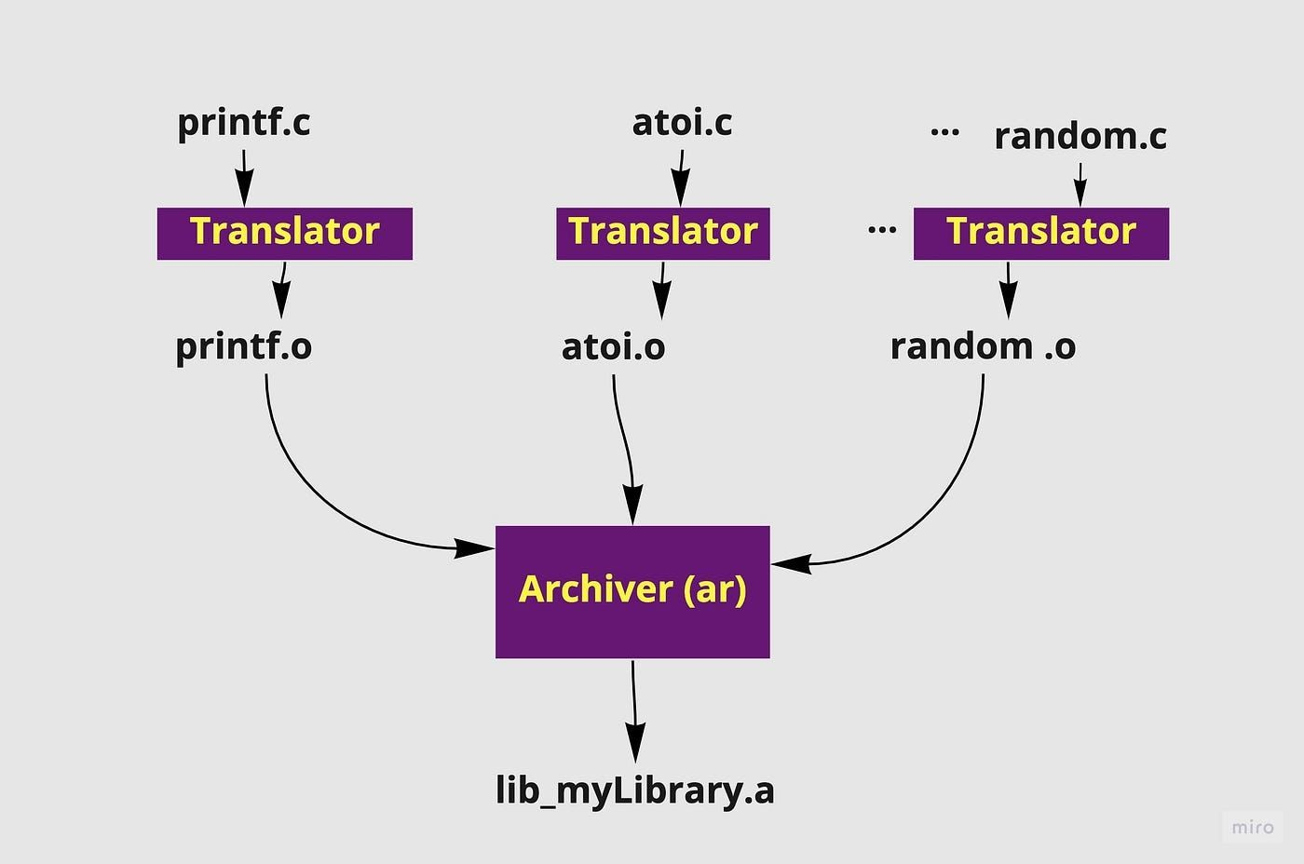
Static Linking and Static Libraries
Create a static library named libmystatic.a
ar rcs libmystatic.a math_operations.o string_operations.o
ar stands for archive and is a Unix utility used to create, modify, and extract files from archives. In the context of creating static libraries, ar is used to package multiple object files (.o files) into a single archive file (.a), which can then be linked into C programs.
The rcs are flags that control the behavior of the ar command:
r (replace): Insert the specified object files (math_operations.o and string_operations.o) into the archive, replacing any existing files with the same name. If the archive does not exist, ar will create it.
c (create): Tells ar to create the archive if it doesn’t already exist. It suppresses warnings about the archive not existing.
s (index): This option generates an index in the archive, which helps speed up symbol lookup when linking the library later. It’s crucial for making the library usable by the linker.
A static library is a collection of precompiled object files (.o files) bundled together into a single archive file with a
.a extension (on Unix/Linux systems) or
.lib extension (on Windows).
Image credit - Mildred Makori @ Medium

Slide 8
Static Linking and Static Libraries
Create the executable
gcc -o myprogram main.c -L. -lmystatic
-o myprogram: Names the output executable myprogram.
-L.: Specifies the current directory as the location of the library.
-lmystatic: Links your program with the libmystatic.a
library.
Why archive (.a) files can be helpful:
Code Reusability
Simplifies Linking
Improved Compilation Speed
Self-Contained Executables
Version Stability
Portability
Verify that myprogram was statically linked
file myprogram #macOS ldd myprogram #linux (dynamic libraries)
Notes:
Note:
ldd only checks for dynamically linked libraries.

Slide 9
Relocation in Dynamic Linking
Relocation in Static Linking
When linking statically, the linker (ld) resolves symbol addresses at compile-time.
It relocates absolute addresses in object files and merges them into a single executable.
Once the executable is created, it contains fixed memory addresses for all symbols, meaning no further relocation is needed at runtime.
You compile math_operations.c and string_operations.c into object files (.o).
The linker resolves all symbols and replaces references to function calls with absolute memory addresses.
The final binary has no dependencies on external shared libraries.
In dynamic linking, the executable contains placeholders (relocation entries) for symbols that will be resolved at runtime.
The dynamic linker (ld.so) loads shared libraries into memory and performs runtime relocation.
This allows shared libraries (.so files) to be updated independently without recompiling the executable.
You compile your program and link against libm.so
dynamically.
The generated executable does not have absolute addresses for sqrt() (from libm.so).
At runtime, ld.so loads libm.so, finds sqrt(), and patches the relocation table to point to the correct memory address.
Notes:
Relocation Techniques
Static Relocation:
Linker (ld) resolves absolute addresses at compile-time and merges object files.
The final binary contains fixed memory addresses and has no external shared library dependencies.
Dynamic Relocation:
The executable contains "placeholders" (relocation entries).
The dynamic linker (ld.so) resolves these at runtime when shared libraries (.so) are loaded.
Allows libraries to be updated without recompiling the main program.

Slide 10
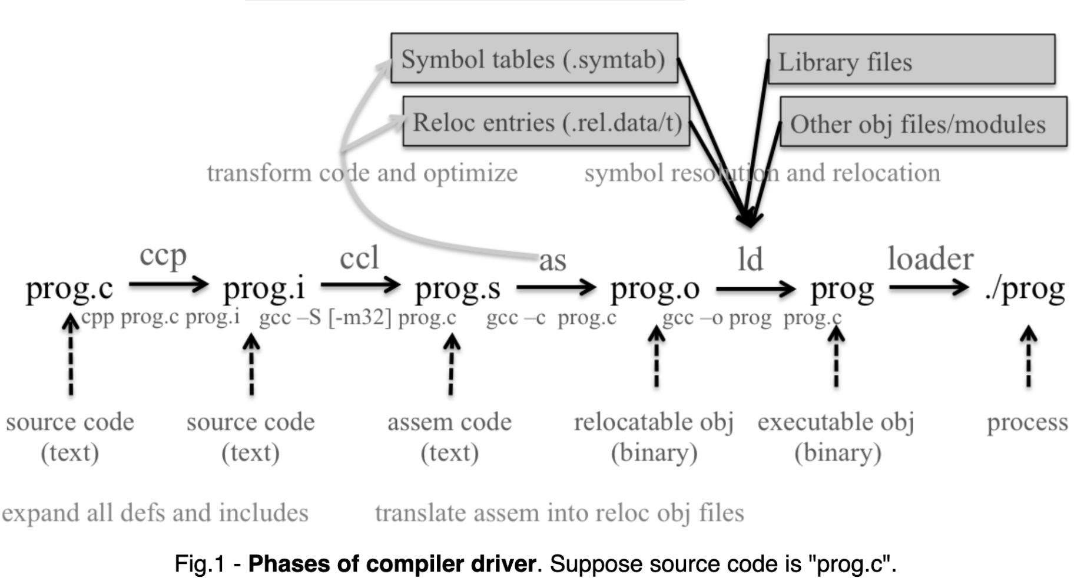
More Information: https://people.cs.pitt.edu/~xiane izhang/notes/Linking.html
Notes:
Figure:
A detailed technical diagram illustrating the phases of a compiler driver,
from source code (prog.c)
through preprocessing,
compilation,
assembly,
and linking to the final executable
and process.

Slide 11
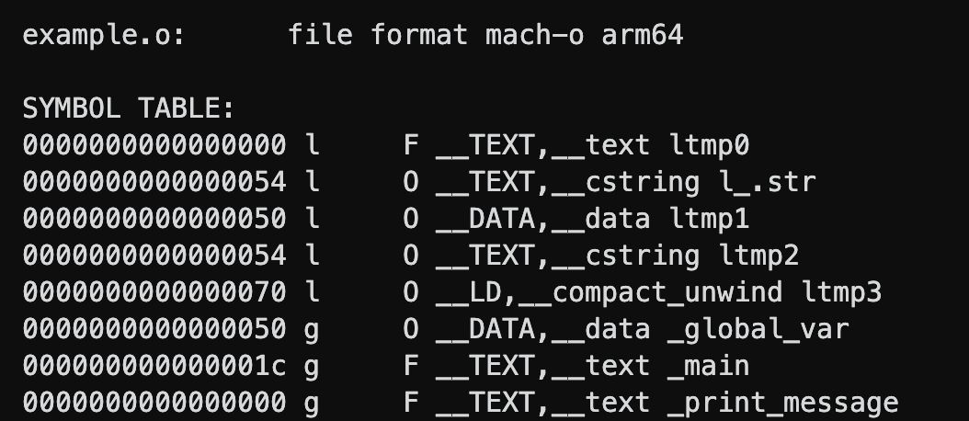
Use gcc to compile it without linking:
gcc -c example.c -o example.o
Run the following command to inspect the symbol table:
objdump -t example.o
Inspect relocation entries using:
Global Symbols (g): These are visible outside the file (e.g., global_var, print_message, main).
Local Symbols (l): These are internal and not exposed (e.g., local_var).
Address: Placeholder addresses (since linking hasn’t happened yet).
objdump -r example.o
Notes:
See example:
Symbol Table Entry directory
Figure:
A terminal output showing a Mach-O arm64 symbol table for an object file,
with a red box highlighting the _print_message symbol at address zero.
objdump:
Used to inspect symbol tables (-t) and relocation entries (-r).

Slide 12
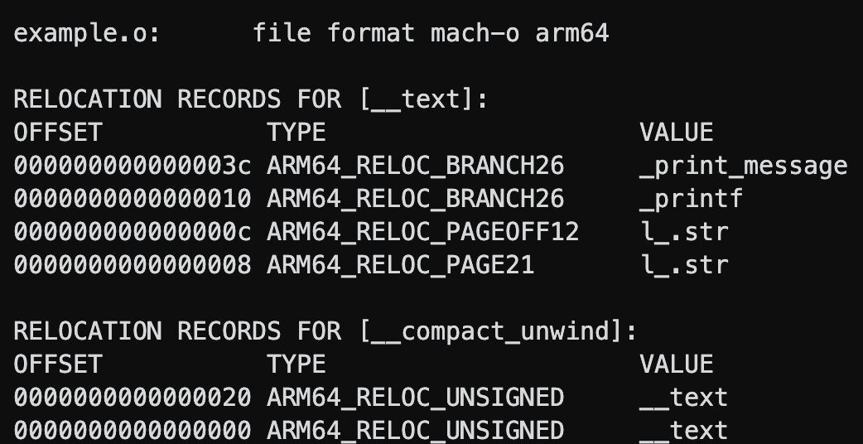
Use gcc to compile it without linking:
gcc -c example.c -o example.o
Run the following command to inspect the symbol table:
objdump -t example.o
Inspect relocation entries using:
objdump -r example.o
RELOCATION RECORDS FOR [.text]: Shows entries for the code section.
Notes:
Figure:
A terminal output listing relocation records for an object file,
showing offsets and types like ARM64_RELOC_BRANCH26
for symbols such as _print_message and _printf.

Slide 13
OFFSET: Location in the .text section where relocation is needed.
TYPE:
R_X86_64_PC32 or ARM64_RELOC_BRANCH26: This means a PC-relative relocation (for function calls like print_message and printf).
VALUE: The symbol that needs to be resolved.
RELOCATION RECORDS FOR [.text]: Shows entries for the code section.

Slide 14
Why Does This Happen?
print_message is a function call, but its address is unknown at this stage.
printf is an external function (from libc), and its actual location is unknown.
The linker resolves these relocations
when creating the final executable.
RELOCATION RECORDS FOR [.text]: Shows entries for the code section.

Slide 15
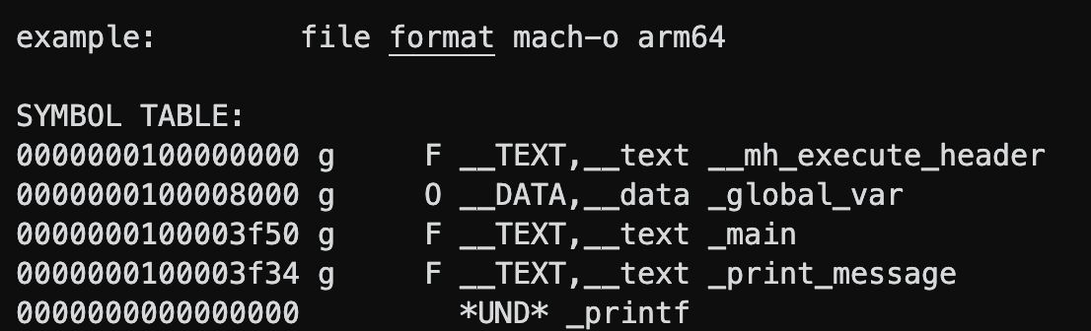
To resolve these relocations and create the final binary:
gcc example.o -o example
Run objdump -t on the linked executable:
objdump -t example
print_message now have actual memory addresses
assigned, meaning the relocation has been resolved.
Notes:
Figure:
A terminal output of a symbol table for a linked executable where _print_message now has a specific memory address and _printf is marked as undefined (*UND*).

Slide 16
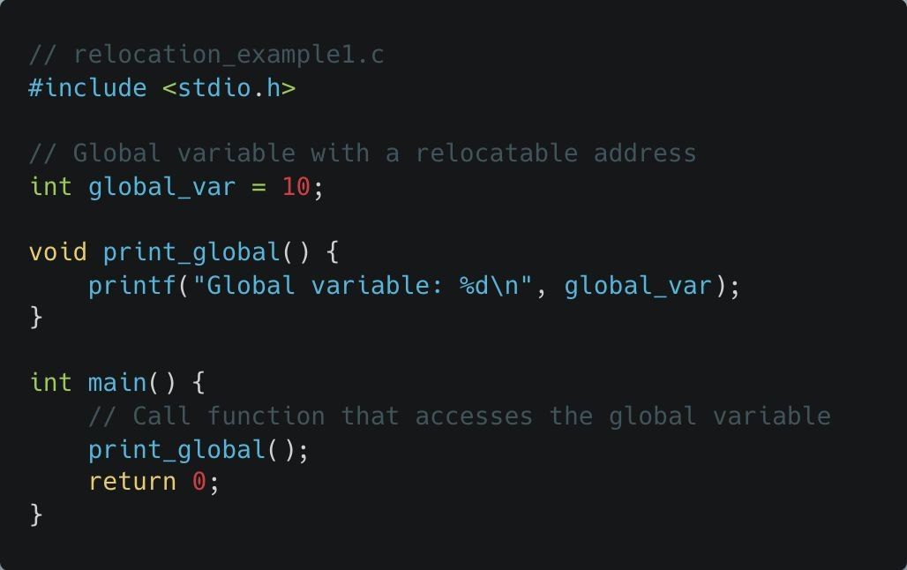
Static Relocation
Before Linking
gcc -c relocation_example1.c
produces an object (.o) file
After Linking
gcc relocation_example1.c
produces an executable output (.out) file
Notes:
Relocation Records:
Shows where code needs patching (e.g., R_X86_64_PC32 for PC-relative calls).
See example:
Static Relocation directory

Slide 17
Static Relocation
Relocatable Addresses: When you compile relocation_example1.c into an object file (relocation_example1.o), the addresses of the global variable (global_var) and the function (print_global) are not fixed. They are placeholders that need to be resolved during the linking phase.
The nm command will show that global_var and
print_global have addresses that are not fixed.
When linking, the linker will resolve these addresses to actual values. If you link this into an executable, the addresses will be updated to their final values.
Let’s compare the output of
nm relocation_example1.o (before linking) and
nm a.out (after linking).
Static Linking: When you run the gcc command to produce a.out, the linker fixes these addresses, making them absolute addresses in the final executable. This is known as static relocation.
Symbol Resolution: The example shows how the linker resolves references to symbols (variables and functions) to their correct memory addresses. The call to print_global() in main() and access to global_var inside print_global() are resolved by the linker.
nm relocation_example1.o
nm a.out
Notes:
nm: Shows symbol types and addresses.
nm is used to list the symbols from
object files, executable files, and object-file libraries.

Slide 18
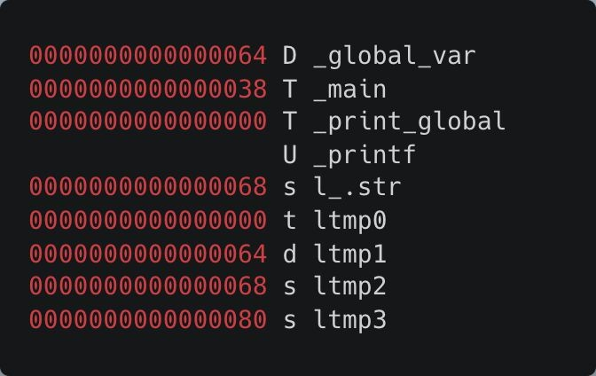
Static Relocation
Address Column (0000000000000064):
This is the address or offset where the symbol is located in the file or memory. For example, 0000000000000064 means the symbol
_global_var is located at address 0x64.
Notes:
A terminal output of a symbol table with various flags (D, T, U)
indicating the status of symbols like _global_var, _main, and the undefined _printf.

Slide 19
Static Relocation
Type Column (D, T, U, etc.):
Symbol Table | Section | Description
D | Initialized Data Section | Global initialized variables
d | Initialized Data Section | Local (static) initialized variables
T | Text Section (Code) | Global functions or code
t | Text Section (Code) | Local (static) functions or code
U | Undefined | Used but not defined in the file
s | Uninitialized Data Section | Local (static) uninitialized variables

Slide 20
Static Relocation
Type Column (D, T, U, etc.):
Data Section (D and d)
D: Represents initialized global or static variables. These are variables that are defined and initialized in your program before execution. They reside in the data section, which contains all global and static variables that are initialized before the program starts.
d: Represents initialized global or static variables that are local to a function (usually defined with the static keyword inside a function).
Notes:
D/d: Data section (global/local initialized variables).

Slide 21
Static Relocation
Type Column (D, T, U, etc.):
Text Section (T and t)
T: Represents the text section, where the executable code or instructions of a program reside. Symbols marked with T are typically global functions or instructions that the program executes.
t: Similar to T, but represents functions or code that are local (not globally accessible).
Notes:
T/t: Text section (global/local code).

Slide 22
Static Relocation
Type Column (D, T, U, etc.):
Other Sections (U and s)
U: Represents undefined symbols, which means that the symbol is declared but not yet defined. It might be resolved by linking with other object files or libraries.
s: Represents uninitialized static variables.
Notes:
U: Undefined (symbols used but not defined in the file).

Slide 23
Static Relocation
Type Column (D, T, U, etc.):
l_.str
This is usually a label for a string literal stored in the read-only data section (often part of the
.rodata section).
The l_ prefix suggests that it is a local label, meaning it is not intended to be accessed outside the scope where it was generated.
For example, if you have a line like printf("Hello, World!\n");, the string "Hello, World!\n" will be stored in the program's memory, and l_.str might be the internal label that the compiler uses to refer to this string in the program's binary.

Slide 24
Static Relocation
Type Column (D, T, U, etc.):
ltmp0 to ltmp3
These are temporary labels or temporary variables that the compiler or assembler generates during code compilation. They are not part of your original source code but are created to manage intermediate results, register allocations, or address calculations.
The ltmp prefix indicates that they are local temporary symbols, typically used only within a small scope, like a single function or code block, and are not meant to be referenced outside that scope.

Slide 25
Static Relocation
Name Column (_global_var, _main, etc.):
The actual name of the symbol in the program. The underscore prefix (_) is a convention used by the C compiler.

Slide 26
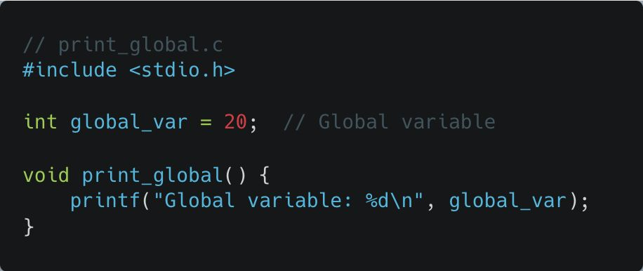
Dynamic Relocation
Compile with Position-Independent Code
gcc -fPIC -c print_global.c
Create shared library
gcc -shared -o libprint.so print_global.o
Display symbol table of shared library
nm -g libprint.so
Notes:
See example:
Dynamic Relocation directory

Slide 27
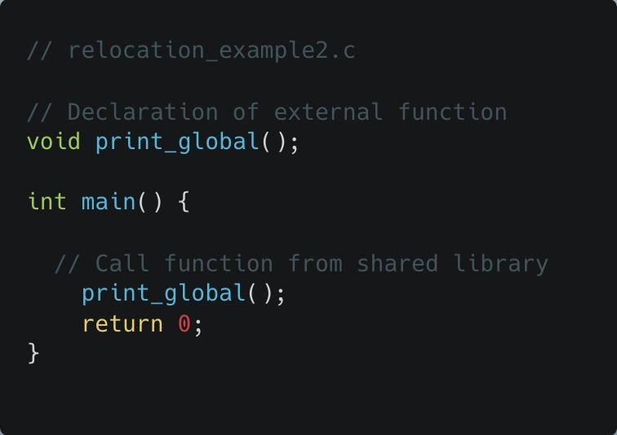
Dynamic Relocation
Compile and Link Against Shared Library
gcc relocation_example2.c -L. -lprint -o relocation_example2
Notes:
nm -g relocation_example2
print_global’s address will be undefined until runtime.

Slide 28
Dynamic Relocation
# This starts your program and the sleep command in the background
./relocation_example2 & sleep 30 &
Notes:
Use this command first before executing:
export LD_LIBRARY_PATH=$LD_LIBRARY_PATH:.

Slide 29
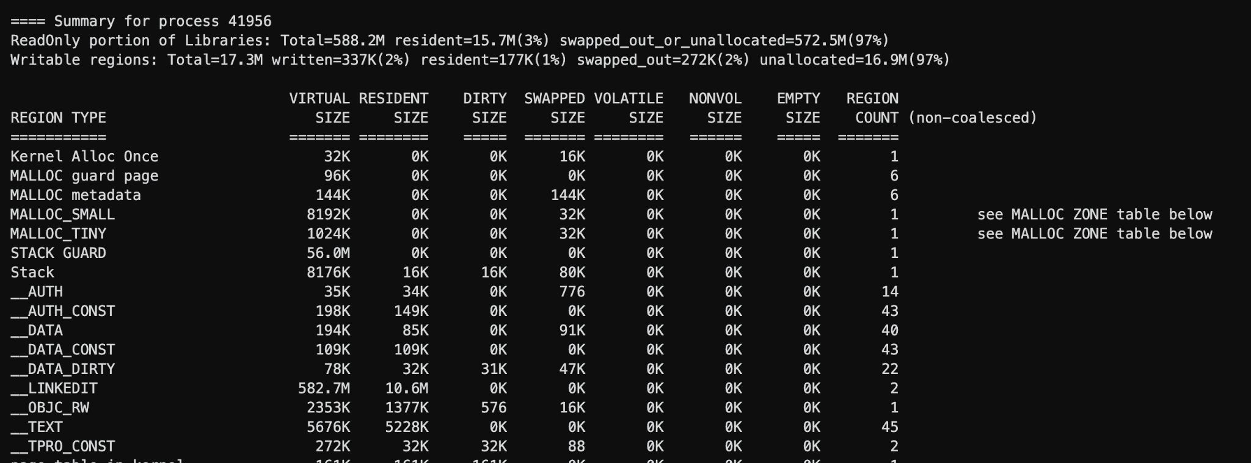
The vmmap command provides detailed information about the memory layout of a process.
vmmap <PID>
Notes:
top:
MacOS: top -o mem
Linux: top -o RES
ps:
Lists processes for the current shell session
ps aux | grep relocation_example2
vmmap:
Provides detailed memory layout for a process.
MacOS: vmmap <PID>
Linux: pmap (not an equivalent)

Slide 30
The vmmap command provides detailed information about the memory layout of a process.
vmmap <PID>
Virtual Size (VSZ)
The total amount of virtual memory allocated to a process.
Important Notes:
Not all of this memory is physically used.
It can be much larger than the actual memory footprint due to memory-mapped files or large allocations.

Slide 31
The vmmap command provides detailed information about the memory layout of a process.
vmmap <PID>
Resident Size (RSS)
The portion of the process's memory that is currently loaded in RAM (i.e., not swapped out).
Important Notes:
Does not include swapped-out memory.
Can fluctuate as the operating system moves pages in and out of memory.
Can never be greater than Virtual Size
Notes:
Resident Size (RSS): Memory actually in RAM.

Slide 32
The vmmap command provides detailed information about the memory layout of a process.
vmmap <PID>
Dirty Size
The amount of memory that has been modified and is not backed by a file.
Important Notes:
Clean pages: Memory that hasn’t been modified or can be easily reloaded from disk (e.g., shared libraries).
Dirty pages: Memory that has been modified by the process and cannot be reloaded from disk.
Notes:
Dirty Size: Modified memory not backed by a file.

Slide 33
The vmmap command provides detailed information about the memory layout of a process.
vmmap <PID>
Swapped Size
The portion of the process’s memory that has been moved to swap space.
Important Notes:
Large swapped size indicates memory pressure.
Frequent swapping can cause performance degradation.

Slide 34
The vmmap command provides detailed information about the memory layout of a process.
vmmap <PID>
Volatile Size
Memory that can be discarded at any time without affecting program execution.
Important Notes:
Mostly relevant in macOS/iOS memory management.
This memory is automatically reclaimed by the OS when needed.

Slide 35
The vmmap command provides detailed information about the memory layout of a process.
vmmap <PID>
Non-volatile Size (Nonvol Size)
Memory that must be retained and cannot be discarded.
Important Notes:
Unlike volatile memory, it cannot be discarded without causing program failure.
Important for memory planning in constrained environments.

Slide 36
The vmmap command provides detailed information about the memory layout of a process.
vmmap <PID>
Empty Size
Memory that has been allocated but is currently unused.
Important Notes:
Helps identify inefficiencies in memory allocation.
A large empty size could indicate over-allocation or fragmentation.

Slide 37
The vmmap command provides detailed information about the memory layout of a process.
vmmap <PID>
Region Count
The number of distinct memory regions allocated by a process. Total number of allocated memory chunks).
Important Notes:
A large number of regions may indicate fragmentation.
Processes with many dynamic allocations or shared libraries will have higher region counts.
Notes:
Region Count: Number of distinct memory regions (high counts may indicate fragmentation).

